Slide 1
Take an african safari August 18 – 27, 2019
Visit:
Nairobi, Ol Pejeta Conservancy, Masai Mara National Reserve, Central Serengeti, Ngorongoro Crater, Lake Manyara National Park
Witness the great migrations
http://itineraries.thejourneyglobe.com/Itinerary/Landing/C55ACD23-CD57-BD29-328D-3AEECF4CB42C

Slide 2
Go on Safari, & learn
Learn & Earn CE:
Dr. Dan Ward:
Using New Improved Dental Materials for Simplified and Predictable Clinical Success (4 hours)
Creating Beautiful Smiles by Design (2 hours)
Nancy Dewhirst RDH,BS
Ergonomics: The Art of Protective Positioning (2 hours, clinic)
Standing up to Emerging Diseases (4 hours)
Visit:
http://www.journeytheglobe.com/?Region=Africa&Country=Kenya&Package=Dental-Group

Slide 3
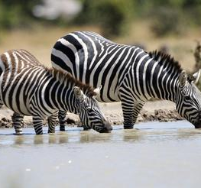
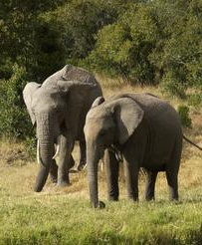
Ol Pejeta Conservancy

Slide 4
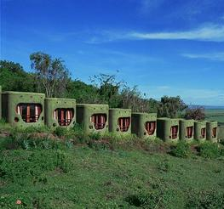
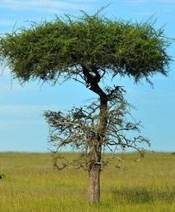
Masai Mara National Reserve

Slide 5
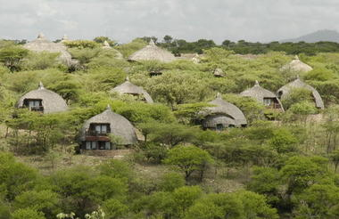
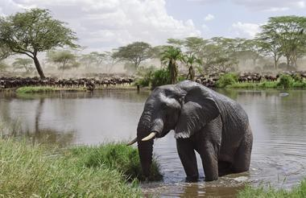
Central Serengeti

Slide 6
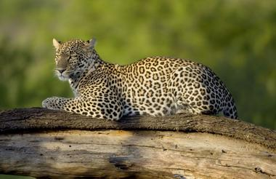
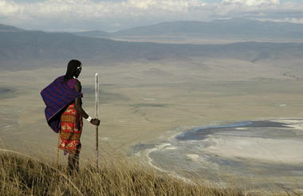
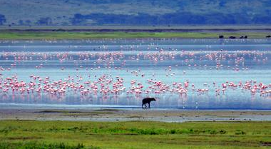
Ngorongoro Crater

Slide 7
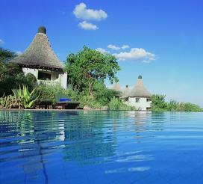
Lake Manyara National Park

Slide 8
More information
Jackie Bishop Martin
1-855-567-0280 info@journeytheglobe.com jackie.bishop.martin http://www.journeytheglobe.com
Go to journeytheglobe.com, select Kenya
Or: direct link =
http://www.journeytheglobe.com/?Region=Africa&Country=Kenya&Package=Dental-Group

